Slide 1

Birth Rate Forecasting and Policy Insights
Team Grapefruit Jacob Brown, Connor White, Dave Hulme
Weber State University CS 6580 – Dylan Zwick

Slide 2
Project Overview
This project analyzes U.S. census, presidential election, and natality data to identify socioeconomic and political factors that influence birth rates. Using historical data from 2010 and 2020, we aim to model how these variables affect birth rates over time and generate predictions for 2030. The results are intended to support data-informed decision-making for government planning and policy development.

Slide 3
Business Question
What specific problem are we solving?
What demographic, socioeconomic, and political factors most strongly influence birth rates at the county and state level, and how can patterns observed in 2010 and 2020 be used to predict birth rate trends in 2030?

Slide 4
Stakeholders
Who is the end-user of this data?
Primary stakeholders include:
County, state, and local governments
Public health agencies
Urban and regional planning departments
These stakeholders can use the findings to anticipate population changes and adapt policies related to healthcare, education, housing, and economic development.

Slide 5
Success Metrics
How will we measure success (technical and business)?
Technical Metrics
Data completeness and successful integration across census, natality, and political datasets
Predictive model performance (e.g., RMSE, MAE, or R² for birth rate forecasts)
Reproducibility of results using version-controlled code and documented workflows

Slide 6
Success Metrics
How will we measure success (technical and business)?
Business / Impact Metrics
Clear identification of key variables influencing birth rates
Actionable insights that are interpretable by non-technical stakeholders
Ability to generate county- or state-level forecasts that inform planning decisions

Slide 7
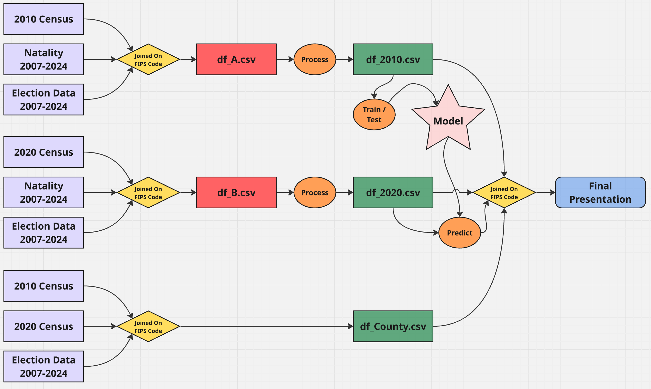
EDA and Join Logic

Slide 8
Models
Baseline Model
Baseline model is a linear regression around the mean of the birth rate data, where each county is predicted to have a birth rate equal to the arithmetic mean of all counties.
The baseline model produced:
RMSE: 1.8811
MAE: 1.4564

Slide 9
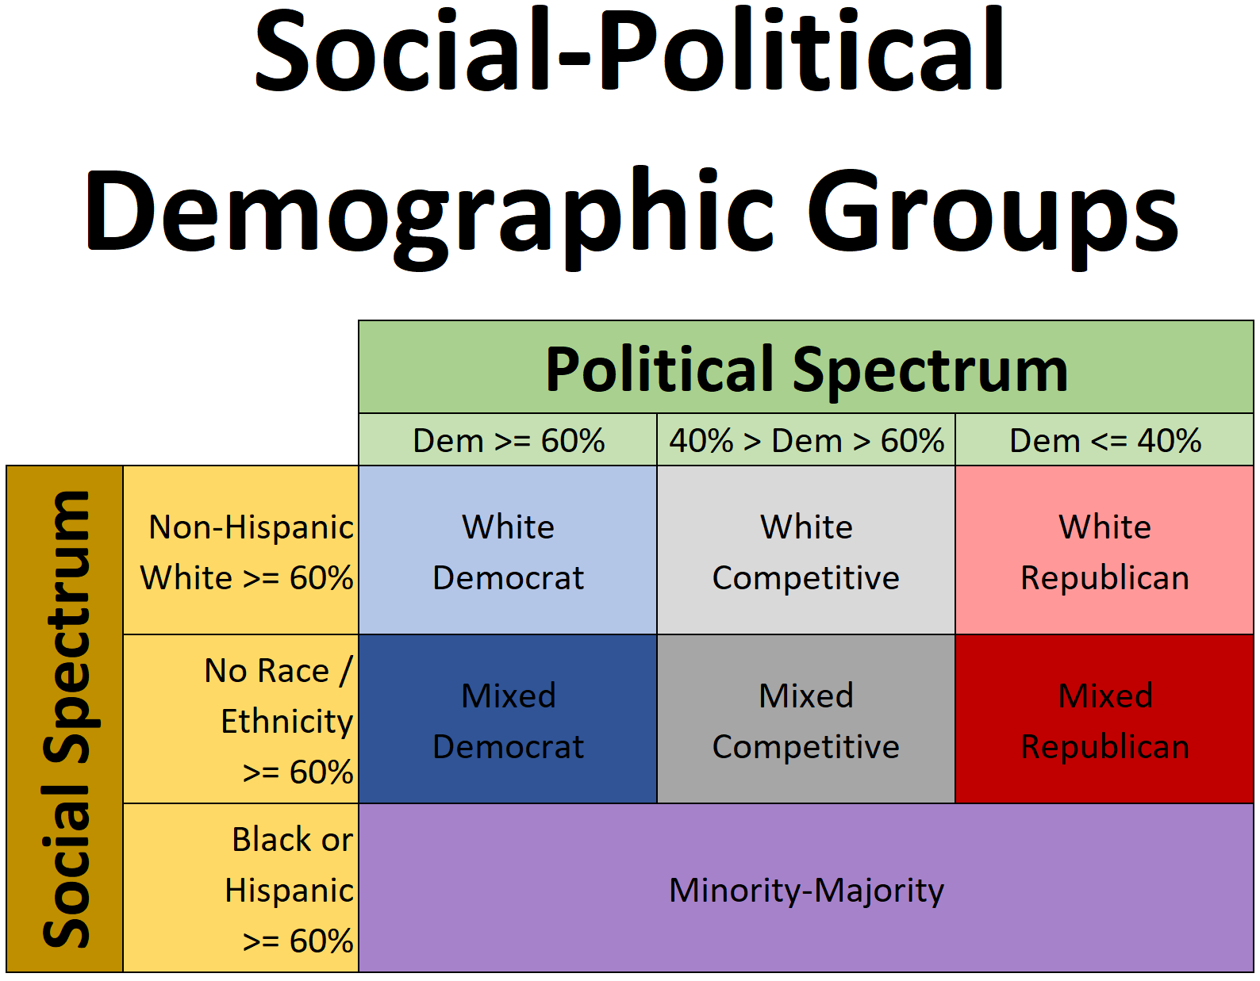
Models
Social-Political Demographic Model
Our champion model is based off the mean birthrate growth within a social-political demographic group.
The champion model produced:
RMSE: 0.7950
MAE: 0.6132

Slide 10
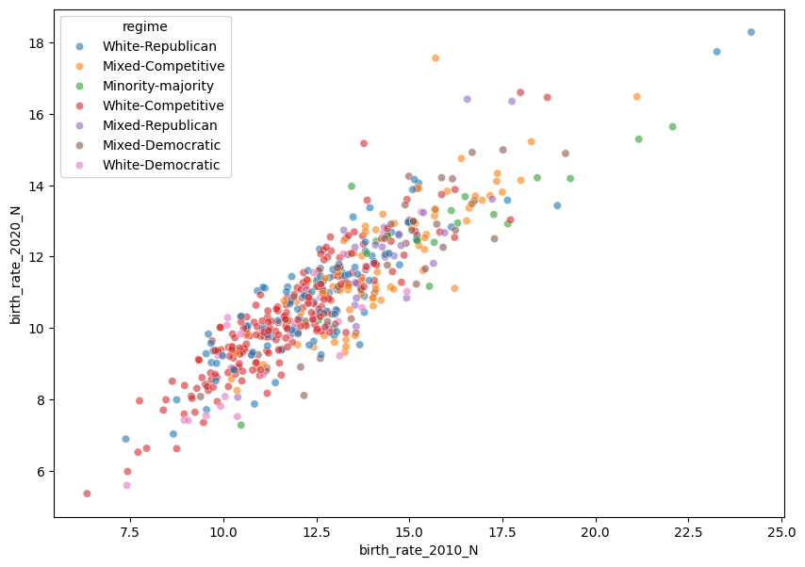
Models
Social-Political Demographic Model (continued)

Slide 11
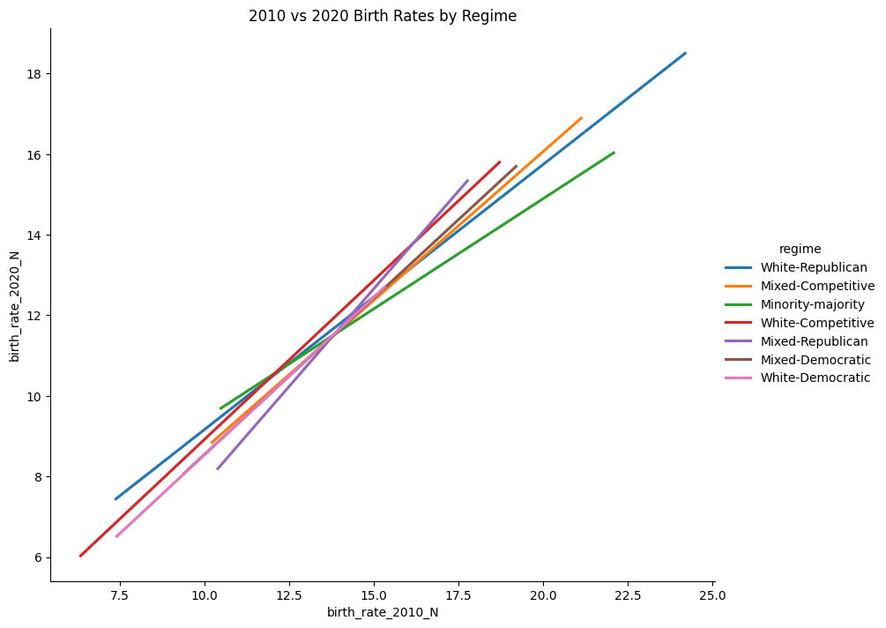
Models
Social-Political Demographic Model (continued)

Slide 12
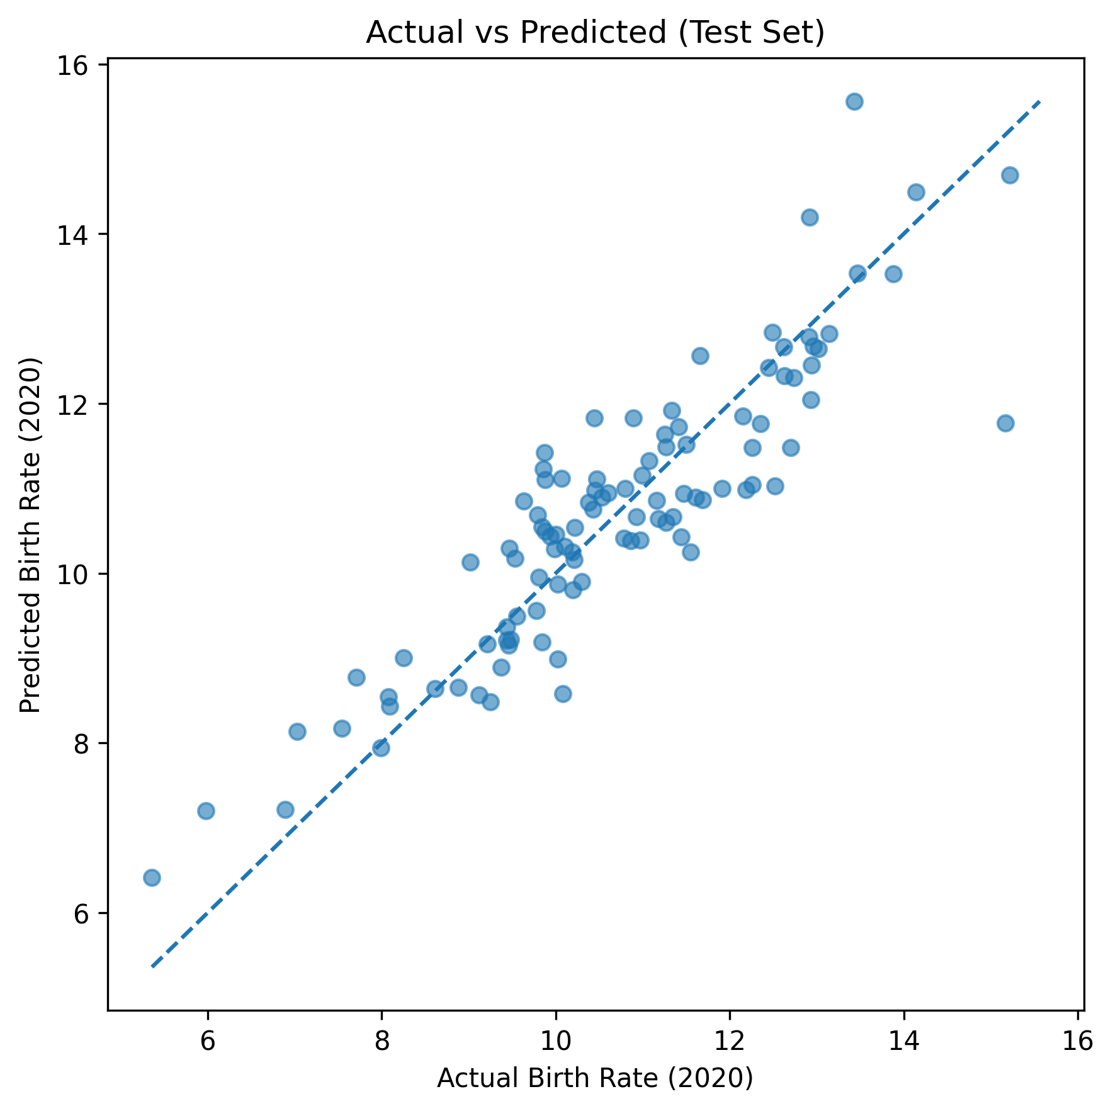
Models
Social-Political Demographic Model (continued)

Slide 13
Demonstration
A live walkthrough of our app.py functioning locally

Slide 14
Conclusions
This walkthrough demonstrates our ability to predict birthrates on a county level, and to provide stakeholders with the data necessary to enact better-informed policies.

Slide 15
Questions / Comments

